Slide 1
Operation NAVIGATOR
Townsville’s ADF Key Personnel Brief

Slide 2
Agenda / Intent
For Key Personnel of formations/units in Townsville to:
Gain a broad understanding of the veteran community in Townsville,
Appreciate the place and capabilities of The Oasis Townsville in ESO and Veteran Communities,
Identify the key problem in ex-serving veteran community and causes,
Understand how Operation NAVIGATOR fits in, and
Seek support for the success of Operation NAVIGATOR

Slide 3
Oasis NAVIGATOR Team
Founder and Chair
LTGEN (Ret’d) John Caligari AO, DSC
General Manager
Angie Barsby
Project Manager
Colleen Maclean

Slide 4
The Bigger Picture
Veterans in Australia by 2021 Census
15,000 veterans in TSV, with families makes veteran community 20% of Townsville community (+more coming)
1 in 6 households in Townsville has a veteran compared to 1 in 20 for Australia
ADF Transitions
600 / year in TSV (10% of ADF transitions)
~200 per year remain in Townsville and region
DVA
have ~2/3 of 600,000 veterans as clients
pensions and compensation, grants, tailored and specific support to the veteran care ecosystem
Veterans Access Network (VAN) Office only in Townsville
Australian ESO Community is disparate and not collaborative (by design? RSL?)
>7,000 ESOs nationally (at 2016 Aspen Study)
>20 incorporated associations Townsville and region (+ others)

Slide 5
Origins of The Oasis Townsville
Operation COMPASS (2017-2022)
More died by suicide in 8 mths 2016 than killed on ops in AFG in 10 years
Significant suicide problem (18-24 years old men, med discharged = x4)
Mission = establish what works to reduce suicide and MH problems in the veteran community
Led to several inquiries and ultimately to the Royal Commission into Defence and Veteran Suicide
The Oasis Townsville Limited
Est. Jan 2018
“Someone to love, something to do and something to look forward to” = Team, Job and a Plan (Immanuel Kant 1724-1804)

Slide 6
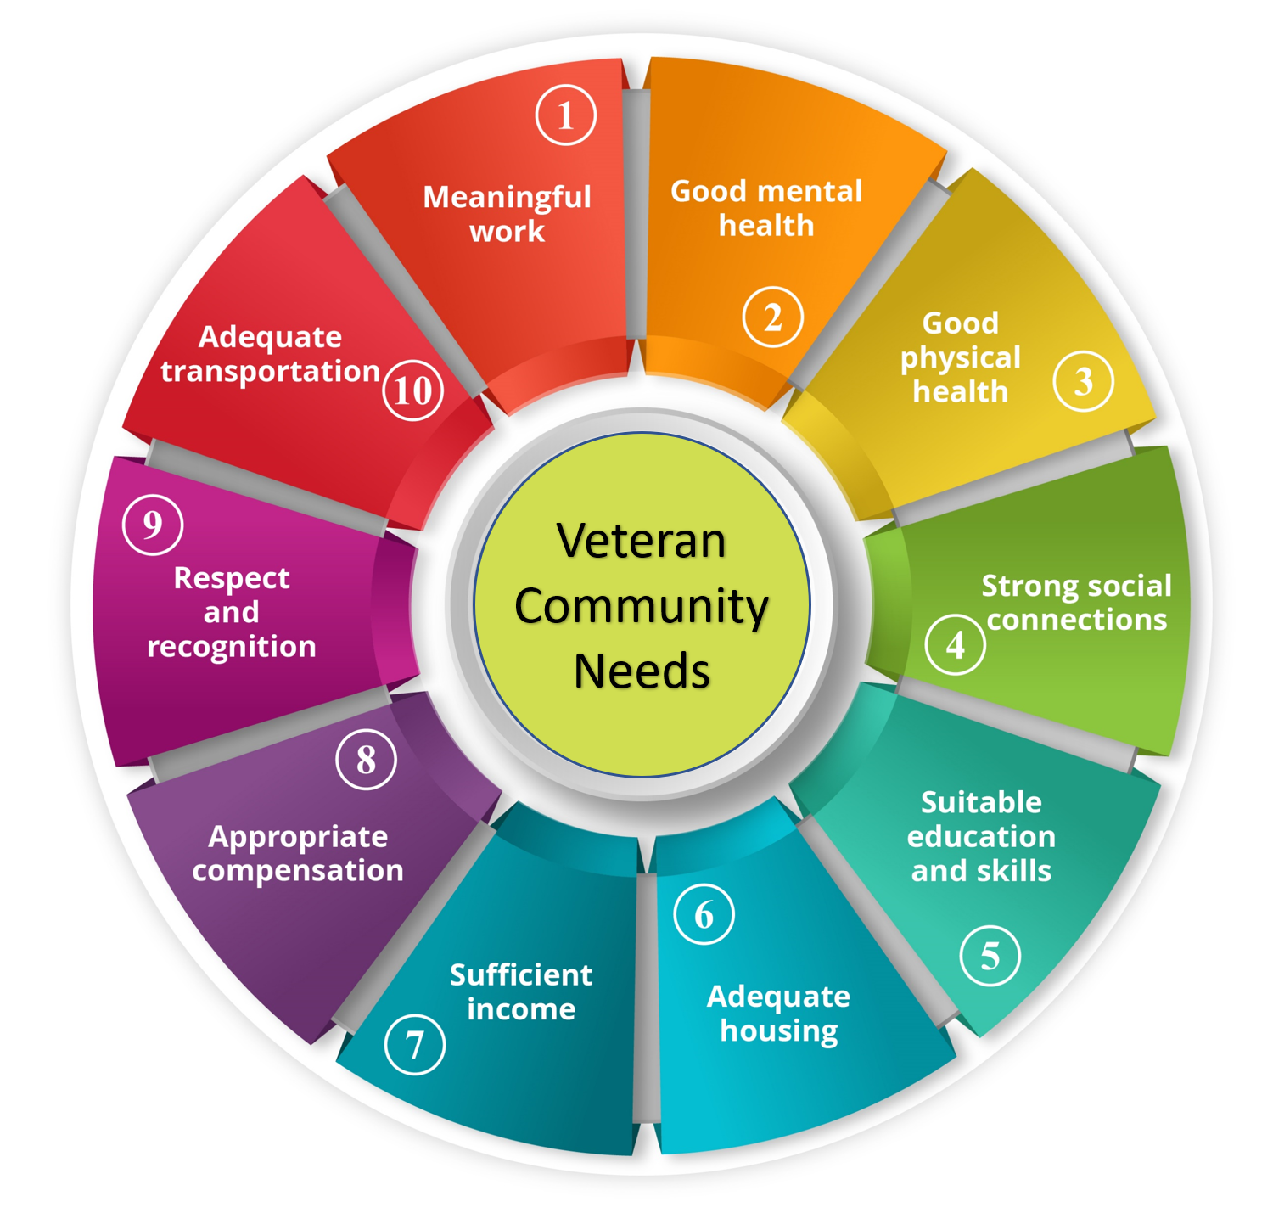
The Oasis Townsville
Homebase for Veteran Community (not ‘Wellbeing Centre’)
All veterans (serving and ex-serving and their partners and families)
Hub for most ESO interactions (services and coordination)
Veteran community leadership (go-to for government, business, sector)
1 of 16 being established around Australia
Connections activities (Team)
270 activities and >4000 attendances per qtr
>50% activities after core hours (0900-1500)
Serving ~ 1200 individuals
Clients (Plan)
Coordinated referrals to veteran supportive organisations/businesses
Currently ~300 active clients on books (~50 intakes and ~50 resolved per quarter)
Serving veterans under 30 years old makeup > 50% of clients in that age group
~80% referred by previous clients or units
Education and Skilling (Job)
Additional to Defence support (grants, scholarships, govt programs)
Including partners and children
Employment and Veterans Business Alliance

Slide 7
Main Problem = Transition
Most significant contributor to poor mental and physical health in the ex-serving veteran community
Productivity Commission, Interim National Commissioner Dr Boss’ Report, DVA/Defence Transition Taskforce Report, Senate Inquiry into Transition
Institutional Responses:
Defence:
Establishment of Joint Transition Authority
ADF Transition Centres at 16 Bases now under JTA (formerly under DMFS)
DVA:
$5mil capital for each of 16 Veterans’ & Families’ Hubs (no operating costs)
No equivalent “operational level” for pairing with ADF Transition Centres (inside the wire and outside) or Primary Health Networks (PHN) x 16

Slide 8
Why is Transition Such an Issue
Culture is different on the civvy side (teamwork, camaraderie, mission focus).
Establishing a new identity can be challenging, esp. the workplace.
Expectation of service (reality is average 7 years) = no preparation.
Over-reliance on DVA and ESOs for support. (missing govt programs such as MyAgedCare, Workforce Australia)
ESOs are demographic-specific (e.g. VVAA, TPI), provide limited services, run by volunteers.
There is a ‘Sea of Help’ and it is difficult to navigate.

Slide 9
Operation NAVIGATOR
The intended effect of Operation NAVIGATOR is to improve serving veterans' appreciation of where they may find themselves in 3, 5 or 10 years. Operation NAVIGATOR focuses on individual preparedness for a soft landing back into the civilian community, from which they can confidently launch the next phase of their life. Having had some support to think and plan early in their career for the inevitable transition will build resilience in individuals that will inoculate them against the most common problems associated with transition, whenever that might occur in the future.
Operation NAVIGATOR is not about commencing transition early.
It is about preparing for the eventuality.

Slide 10
Evidence of the Need (What we are seeing)
Smart: Increasing number of serving veteran clients who self-refer to seek information/support but have no intent yet to transition.
Circumspect: Some serving veterans are thinking of transition but do not want to signal their possible intent to the chain of command or peers yet.
Despairing: Many serving veterans have started their transition for the wrong reasons (e.g., angry or disillusioned) and are often put back on track by better-appreciating Defence/ADF options.

Slide 11
NAV Components
Operation NAVIGATOR has four components:
a one-day workshop (Solid Foundations) for all those service personnel posted to Townsville on their first posting in the ADF, after completing their initial employment training;
a menu of presentations throughout the year (known as NAV Sessions), at times that are suited to serving veterans and their partners, on topics that cover the 10 Veteran Community Needs;
an Intake Process for anyone seeking specific information/support; and
the Oasis NAV App has the tools and resources to support each of the three components above.
Overarching Oasis App allows for entry/access in multiple ways to suit individual needs (esp. if affected by mental health problems)

Slide 12
Solid Foundations Workshop
Soldiers, aviators, and sailors on first posting to TSV after initial training
Attend one day only within 12 months of arrival in TSV
Tuesdays 0920h to 1500h
Block one 20 Feb – 26 Mar = 6 Tuesdays
Continual update of info requirement on the Oasis NAV App
Observers/Visitors policy (by negotiation, no uniforms)
Reporting numbers by unit only – no names

Slide 13
Your Support for The Oasis Townsville
Identify individuals and ensure attendance at SFW as appropriate
Promote general awareness of Homebase (a safe place)
Promote connections activities at Homebase
Encourage UWO and C2 to utilise our client services as appropriate
Encourage attendance “RSL Townsville Banjo Breakfast” (off-pay Fri)
Utilise for off-site activity (park, aircon, coffee, internet, VTC)
Support proposal for service transport to Homebase
Encourage unit RI to utilise our “EKO Coffee” in unit cafés

Slide 14
Questions?

Slide 15
Backup Slides

Slide 16
Solid Foundations Program Outline
Icebreaker at Dirty Boots Café (0920-0930)
Emphasis on driving info requirement back to the Oasis NAV App
Intro to The Oasis Townsville and Purpose of Workshop
Videos and Tour
Self-awareness, Goal Setting and Social Connections
Job Satisfaction, Retention in ADF and Education and Skills
Remainder of 10 Veteran Community Needs
health, compensation explained, My Gov/DVA’s MyService, Help Lines available
Close 1500h
Notes:
The solid foundations workshop is not teaching them everything they need to know . That would be overwhelming and there is already an information over load on a lot of these areas. The workshop will lay the foundations for participants to grow, learn and navigate the information when they need it. We give them to tools that allow them to start to implement small incremental changes that suit their personal situations and continuously build on it as they move through their ADF careers.
Evaluation survey – particpants will be invited to particpate in a pre and post workshop survey. This survey will be to evaluation the effectiveness of the workshop for building confidence of participants knowing where to go to gather information when they need it.
We meet you where you are, no matter where you are in the process. The earlier the better; further upstream before you hit the rapids so you are better equipped when the white water starts to get rough.
Think of it as a fundamentals workshop. They wont leave being experts in transition, but will have the background knowledge to build from.
Learning from lived experience.

